Slide 1
Regional Dialect Identification for African American English Speakers
EC ENGR M214A
Final Project Presentation
Group 3
Ajit Pandey
Partha Kundu
Lindsey Smith
Notes:
Lindsey

Slide 2
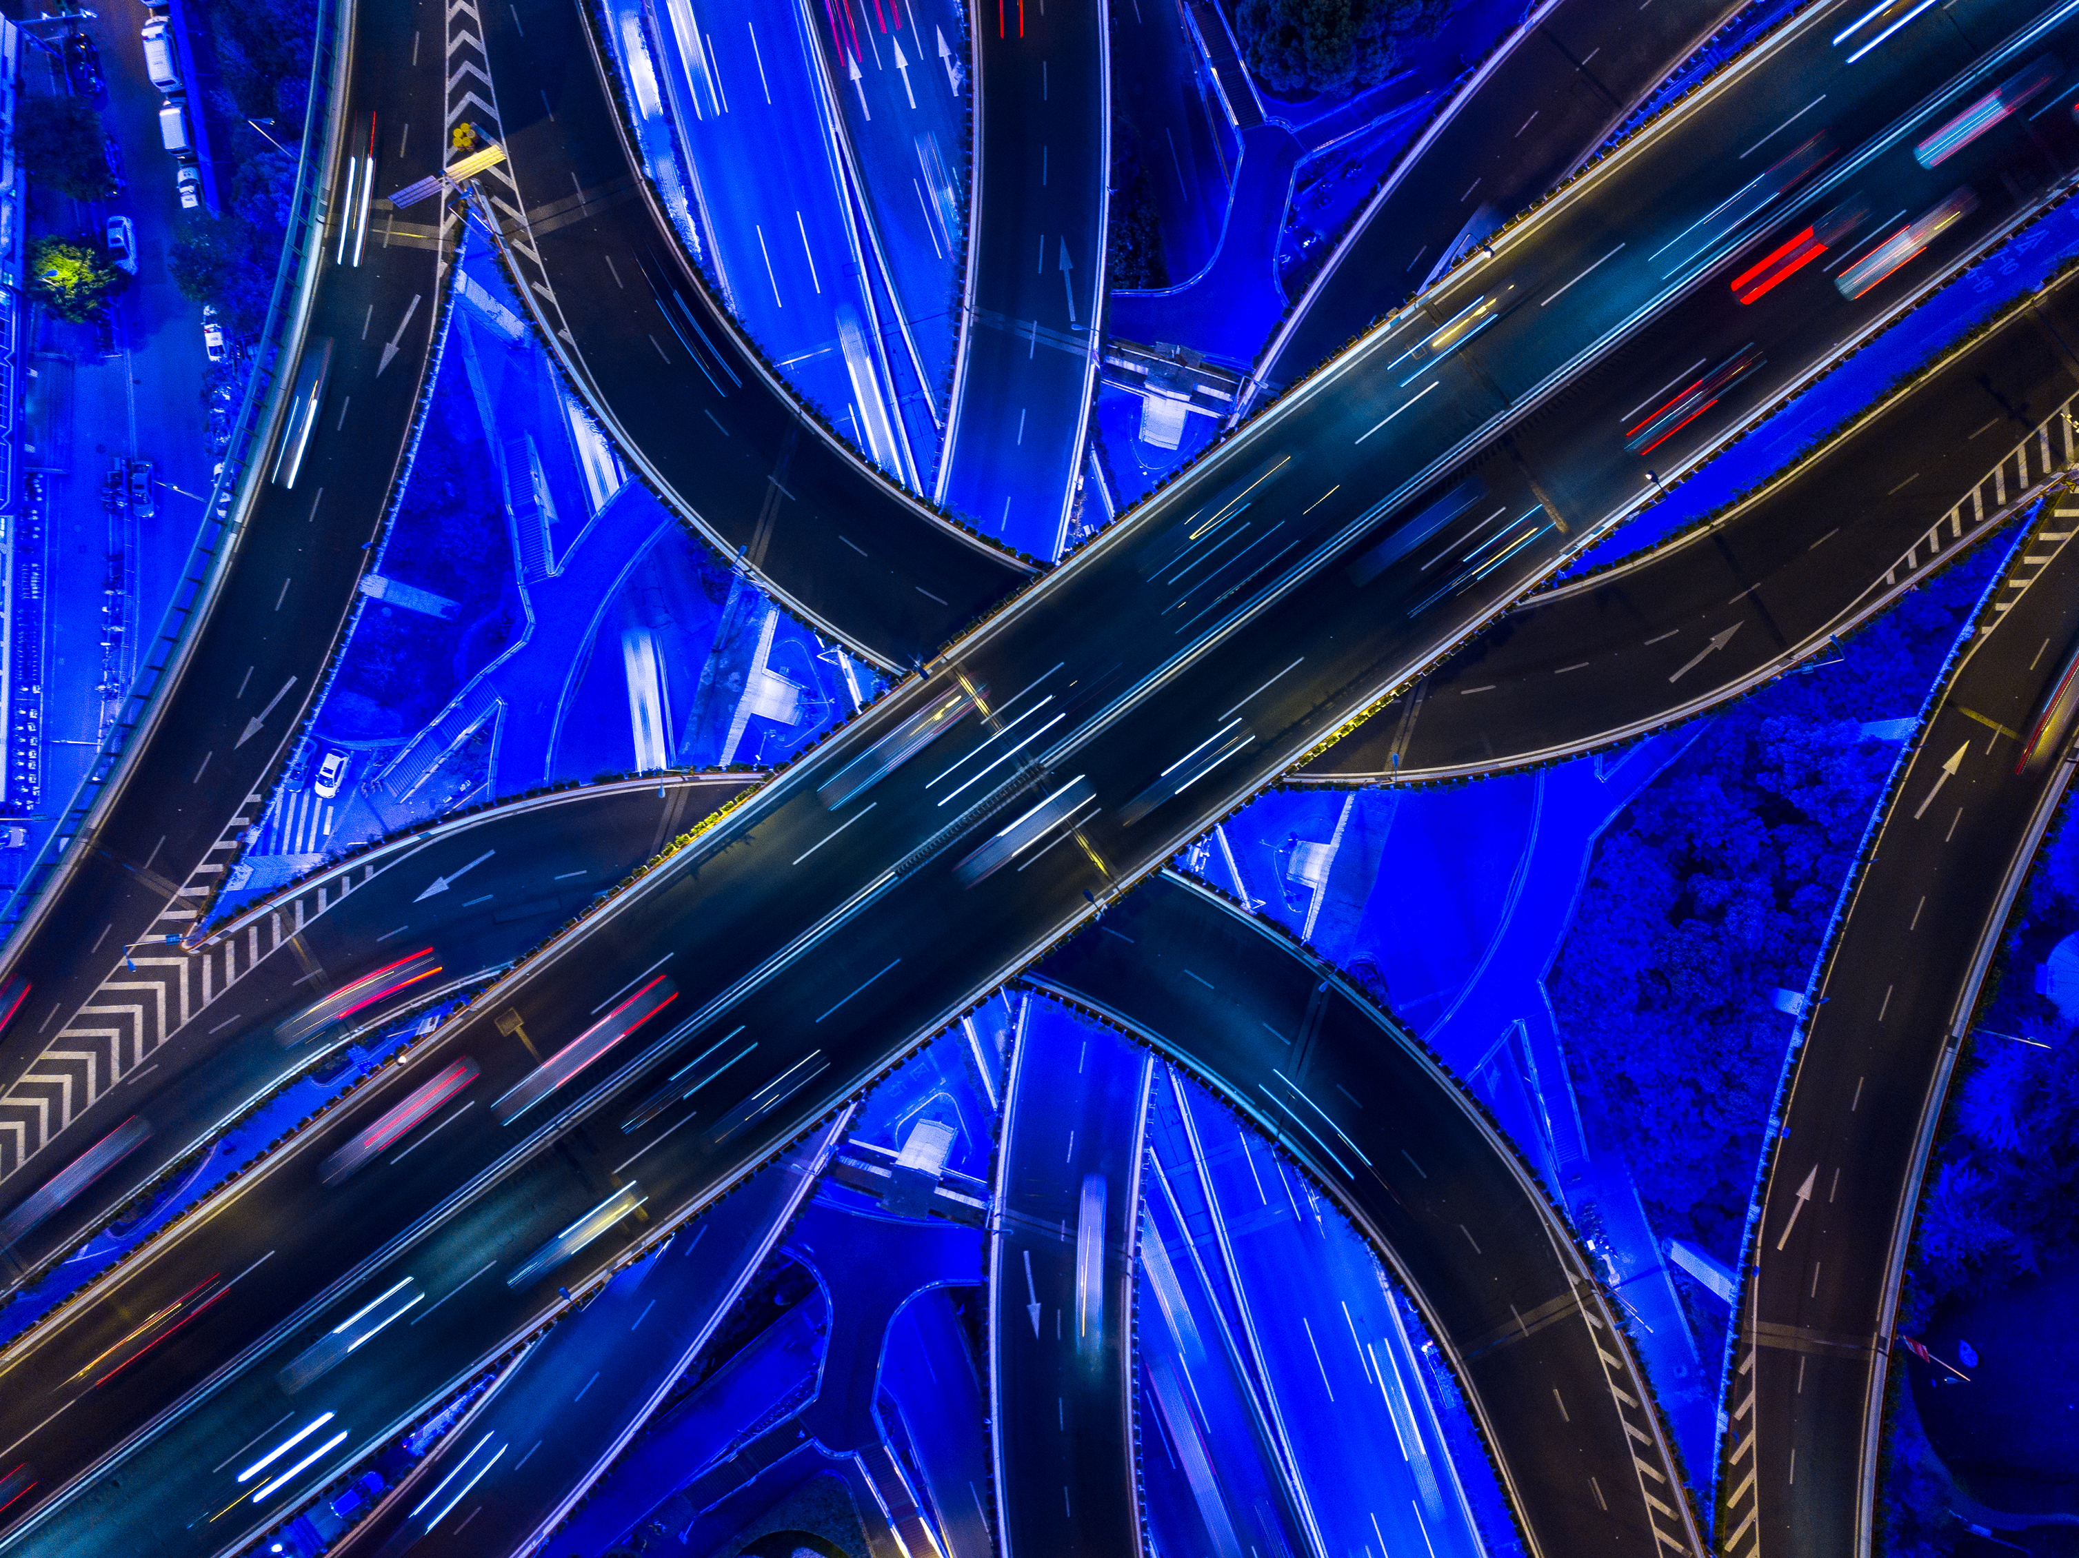
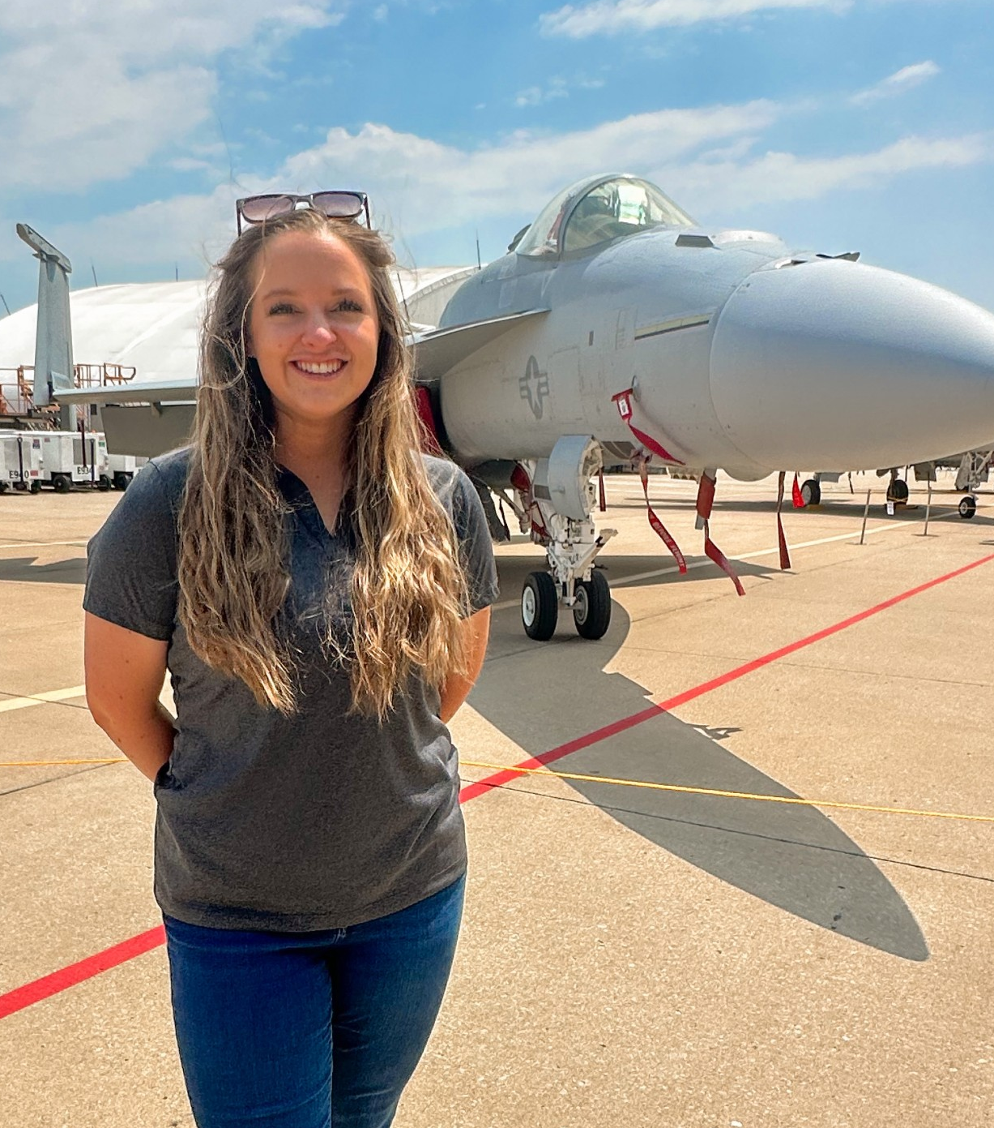
Team 3
Ajit Pandey
Placeholder
Partha Kundu
Placeholder
Lindsey Smith
Electrical Engineer
Notes:
Lindsey

Slide 3

Agenda
Introduction
Approach
Filtering
Feature Selection
Final Results
Conclusions
Notes:
Lindsey

Slide 4
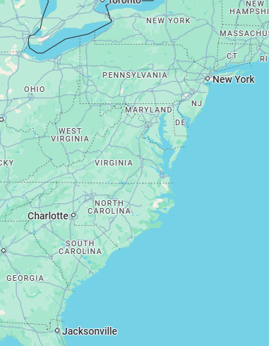
Introduction
Speech signals carry characteristic information about the originating speaker including regional origin
This project uses audio signals from the Corpus of Regional African American Language (CORAAL) database to train and establish an African American speaker region identification system
The dataset is taken from male and female speakers from 6 U.S. cities speaking within noisy and clean environments
Different features are extracted from the audio files in the dataset which are then used to train an XGBoost classifier to predict the area of origin for each speaker
The objective of this project is to exceed an accuracy threshold of ~70% through strategic feature selection
Detroit, MI
Rochester, NY
Lower East Side, Manhattan, NY
Washington, DC
Princeville, NC
Valdosta, GA
Notes:
Lindsey

Slide 5
High level Approach
Import audio data
Preprocess data
Apply filtering
Extract feature sets
Create labels
Concatenate feature data
Train model
Test model
Analyze and plot results
Notes:
Ajit

Slide 6
Filtering Methods:
Whitening Filter
What is a whitening filter
Why we chose to use it
How it worked for our code
How and where it was implemented in our code
Spectral gating Filter
Results?
In work, Ajit to provide input
Notes:
Ajit

Slide 7
Feature Extraction: mfcc
Characterizes the short-term power spectrum of the audio signal
Represent speech formats using frequency bands equally spaced on the mel-scale
Effective at capturing speaker characteristics
MFCC, delta, and delta-delta
Used 13 MFCCs to capture relevant frequency information
Results
Produced decent accuracy
ACCURACY
Train (Clean) | 100%
Test (Clean) | 51.9%
Test (Noisy) | 50.0%
Notes:
Lindsey
Note that we don’t have anything to compare this to just yet

Slide 8
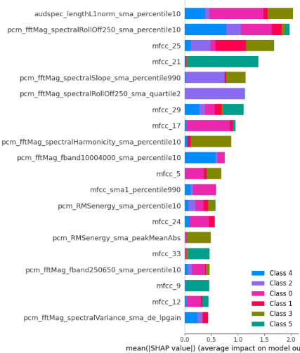
Feature Extraction: openSMILE - ComParE_2016
(MFCC + ComParE)
OpenSMILE is an open-source toolkit for feature extraction of audio files
ComParE is an openSMILE feature set comprised of 6,373 features
Detects prosodic features – pitch, loudness, roll-off
Computes statistics – mean, variance, regression coefficients
Results
Accuracy improved compared to MFCC run
Higher number of features represented in the ComParE data frame
More robust to background noise
No statistical analysis for MFCC
ACCURACY
Train (Clean) | 100%
Test (Clean) | 61.6%
Test (Noisy) | 58.8%
Notes:
Lindsey
Open-source Speech and Music Interpretation by Large-space Extraction
Noisy environments can degrade MFCC-based models, as MFCCs are highly sensitive to background noise.
ComParE includes features that are more robust in noisy conditions, such as energy-related features and dynamic spectral characteristics.

Slide 9
Feature Extraction: openSMILE – GeMAPSv01b and eGeMAPSv02
GeMAPSv01b
Train (Clean) | 97.4%
Test (Clean) | 28.7%
Test (Noisy) | 24.6%
GeMAPSv01b – speech, loudness, and spectral features
62 total features
eGeMAPSv02 – next version that added more frequency and spectral features as well as jitter and shimmer
88 total features
Tested both to understand and compare to ComParE_2016
Results
As expected, eGeMAPSv02 outperformed GeMAPSv01b
As expected, ComParE_2016 outperformed each
GeMAPS computes less features thus uses less processing time
Could be optimal for other applications which prioritize fast processing over high accuracy
eGeMAPSv02
Train (Clean) | 99.4%
Test (Clean) | 28.0%
Test (Noisy) | 31.4%
ComParE_2016
Train (Clean) | 100%
Test (Clean) | 61.6%
Test (Noisy) | 58.8%
Notes:
Lindsey

Slide 10
Feature Combination
MFCC ACCURACY
Train (Clean) | 100%
Test (Clean) | 51.9%
Test (Noisy) | 50.0%
MFCC + ComParE
Train (Clean) | 100%
Test (Clean) | 65.2%
Test (Noisy) | 62.8%
ComParE ACCURACY
Train (Clean) | 100%
Test (Clean) | 61.6%
Test (Noisy) | 58.8%
Concatenating features significantly improved performance!
Notes:
Lindsey

Slide 11
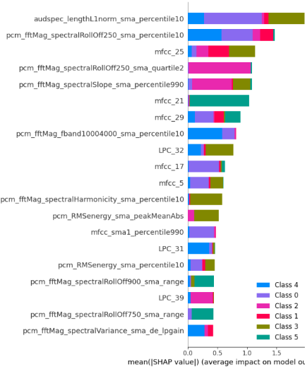
MFCC + ComParE + Linear Predictive Coding (LPC)
(MFCC + ComParE + LPC26)
Represents audio signal as a linear function of previous samples using a 26-order model
Uses prior 26 samples to predict the next sample
26 coefficients characterize the vocal tract filter
Results
Test noisy accuracy significantly improved
WHY?
When run independently, LPC provided excellent results
ACCURACY
Train (Clean) | 100% | -
Test (Clean) | 68.1% | (+2.9)
Test (Noisy) | 73.0% | (+10.2)
We might want to double check the test noisy results.. Seems too good to be true
Notes:
Partha

Slide 12
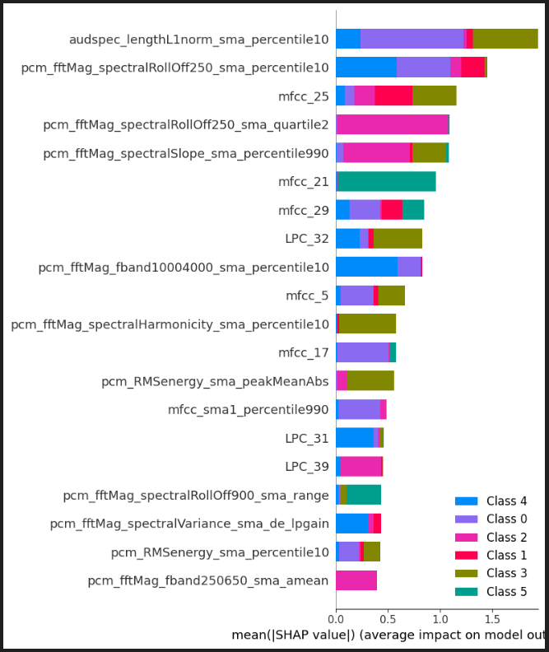
(MFCC + ComParE + LPC26 + PLP)
MFCC + ComParE + LPC
+ Perceptual Linear Prediction (PLP)
Focuses on representing the signal to model how a human would perceive it using psychoacoustic principles
Utilizes critical band filtering on the mel-scale
The human ear perceived sounds in critical bands corresponding to the cochlea
Compresses signal intensity to model loudness similar to the human ear
Results
Accuracy slightly improved
Only lesser influential characteristics changed in shap importance ranking
Critical band filtering improves noisy performance by focusing on perceptual sounds
Beginning to reduce the amount of accuracy improvement as more methods are added
ACCURACY
Train (Clean) | 100% | -
Test (Clean) | 68.3% | (+0.2)
Test (Noisy) | 73.1% | (+0.1)
Notes:
Partha
In psychoacoustics, the human ear perceives sound in a way that is not linear across frequencies. The ear divides the frequency spectrum into several bands (critical bands), each of which corresponds to a specific region in the cochlea of the inner ear. These bands are not uniform but vary in width depending on the frequency. For example, at higher frequencies, the critical bands are wider, while at lower frequencies, they are narrower.

Slide 13
MFCC + ComParE + LPC26 + PLP + PNCC
(MFCC + ComParE + LPC26 + PLP + PNCC)
Perceptual Nonlinear Cepstral Coefficients
Introduces nonlinear frequency scaling to the model, previously used mel-scale and linear scale
Focuses on lower frequencies, not higher frequencies
Results
Accuracy improved for noisy test
As expected, more improvement was seen in the noisy environment compared to the clean environment
PNCC is robust to high frequency noise
ACCURACY
Train (Clean) | 100% | -
Test (Clean) | 68.3% | (+0.0)
Test (Noisy) | 73.6% | (+0.5)
Notes:
Partha
Previously, we introduced features that use the mel frequency scale or linear frequency scale

Slide 14
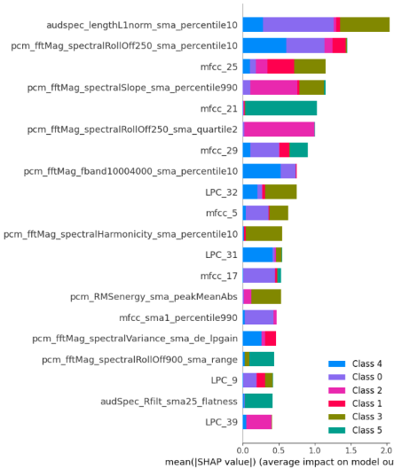
(MFCC + ComParE + LPC26 + PLP
+ PNCC + Wav2Vec2)
MFCC + ComParE + LPC26 + PLP + pncc + Wav2Vec2
Unsupervised speech recognition model that predicts unknown parts of the signal using the surrounding parts for context
Because the model trains itself through the context of other inputs, this is useful where the model can adapt to different regional dialects with limited training data available
Results
Accuracy significantly improved
More robust to noise due to raw unlabeled audio learning allowing the model to distinguish between the core speech signals and the various noise signals present throughout the dataset
ACCURACY
Train (Clean) | 100% | -
Test (Clean) | 68.8% | (+0.5)
Test (Noisy) | 74.7% | (+1.1)
Notes:
Partha

Slide 15
Feature Extraction: Other methods
The following methods degraded model performance
Wav2Vec2 Combined:
PLP_Delta_Delta: Used PLP extracted features to capture the rate of change of the PLP coefficients and the rate of change of the deltas to improve recognition
GTCC:
LFCC:
i-vector:
x-vector:
Results
Accuracy declined
Potentially due to overfitting of the training set
Model could have become more sensitive to noise variations by capturing deltas
PLP_D_D ACCURACY
Train (Clean) | 100% | -
Test (Clean) | 67.9% | (-0.9)
Test (Noisy) | 74.1% | (-0.6)
Put all other methods that didn’t improve results on this one chart

Slide 16
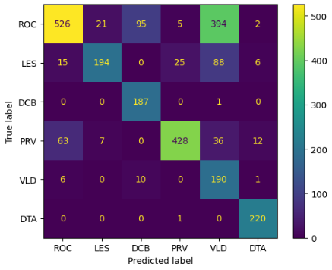
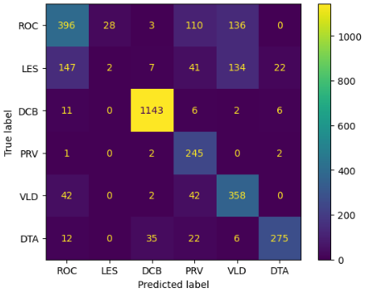
Conclusion: best Results
Methods not included
Wav2Vec2 Combined
PLP Delta Delta
GTCC
LFCC
x-vector
i-vector
MFCC
ComParE
LPC26
PLP
PNCC
Wav2Vec2
Class imbalance
Overfitting
Black box assumption
ACCURACY
Train (Clean) | 100% | -
Test (Clean) | 68.8% | (+0.5)
Test (Noisy) | 74.7% | (+1.1)
Notes:
Ajit

Slide 17
Questions?
Notes:
Ajit

